Slide 1
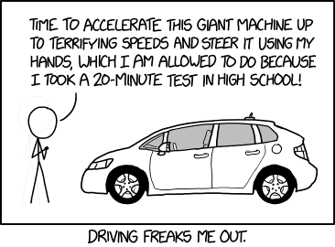
Teaching Machines to Race Cars
From Random Actions to Expert Drivers
January 2026
Dr SSgt Scott Grandison

Slide 2
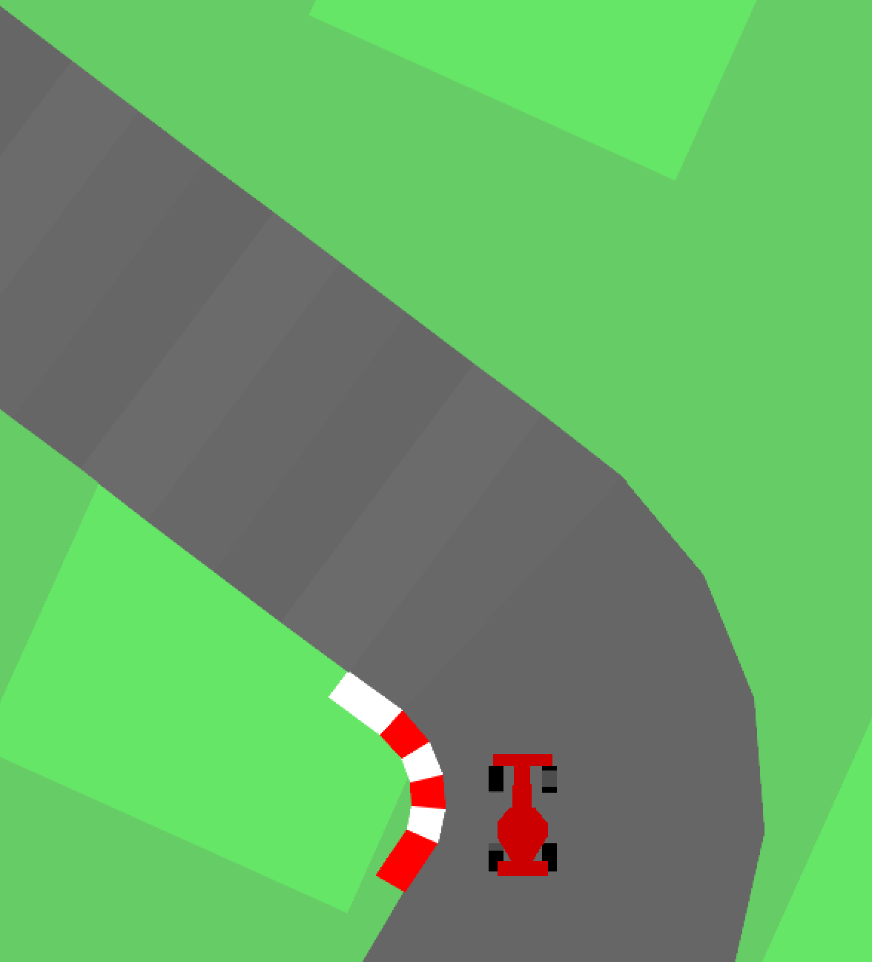
What We're Building
A racing car simulation where AI learns to drive
Racing car navigates a track autonomously
No pre-programmed instructions
Learns through trial and error
Improves performance over thousands of attempts Competes against other AI-trained cars

Slide 3

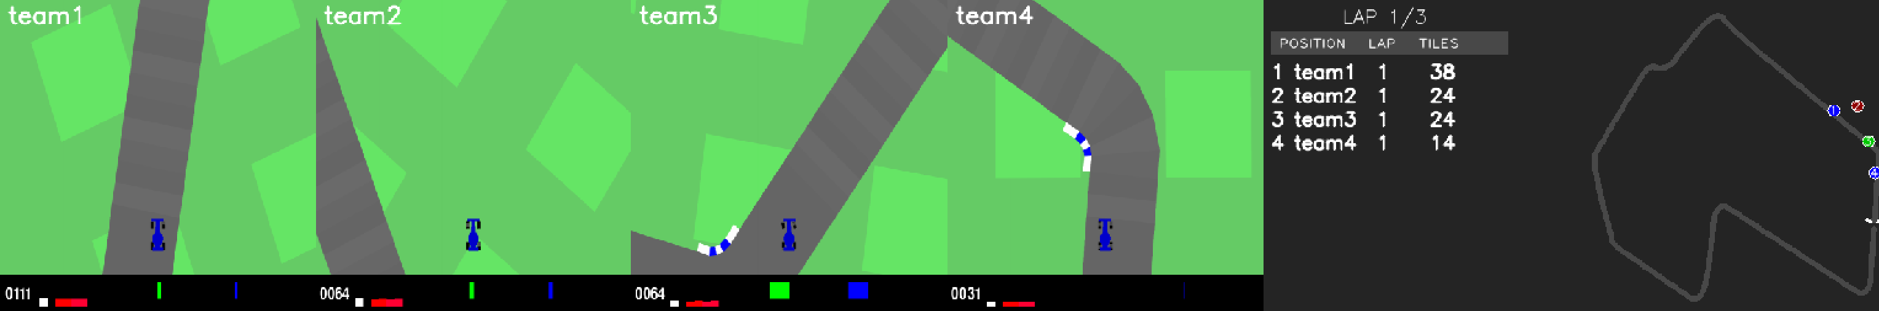
Competition Format
How the Competition Works
1.
2.
3.
4.
5.
Each team trains their own AI racing car
All cars use the same DQN algorithm framework
Teams customize rewards, parameters, and strategies
All trained cars compete on the same track
Performance measured by lap times and consistency
Every team starts from zero knowledge—the AI must learn from scratch

Slide 4


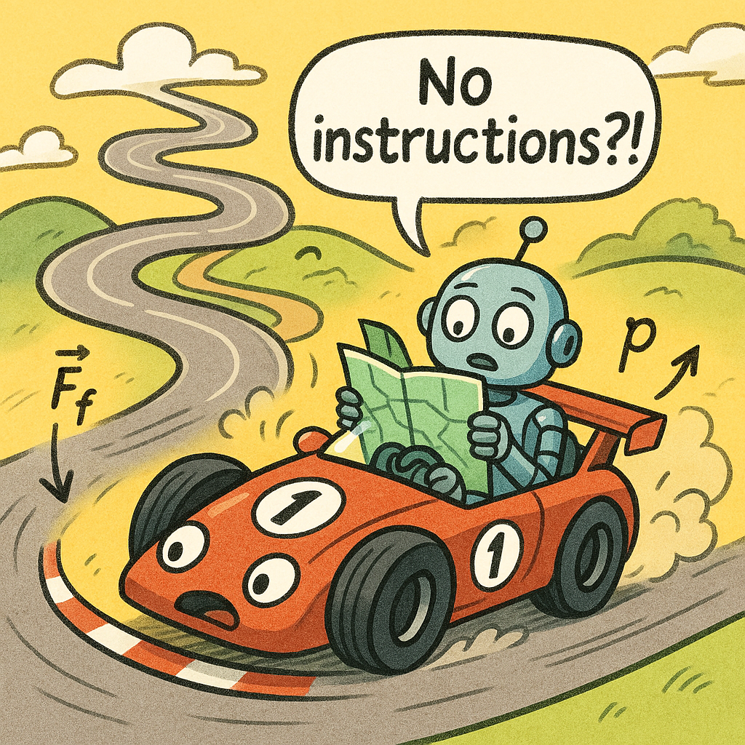
Why This Is Challenging
Teaching a car to race autonomously presents unique challenges that make this problem difficult for AI
No Explicit Instructions
The AI doesn't receive step-by-step driving instructions. It must discover how to navigate the track entirely on its own through experimentation.
Balance Speed & Control
The car must learn to maximize speed while maintaining control. Too fast and it crashes; too slow and it loses the race. Finding the optimal balance is non-trivial.
Complex Physics
The simulation includes realistic physics: acceleration, friction, momentum, turning radius. The AI must learn how all these factors interact to drive effectively.

Slide 5
Traditional Programming vs. AI Learning
Traditional Programming
Human defines every rule
Programmer writes IF-THEN rules
Define speed limits for each curve
Specify exact steering angles
Hard-code response to each scenario
Manually test and adjust each rule
AI Learning (Reinforcement Learning)
AI discovers rules through experience
AI tries random actions initially
Receives rewards for good behavior
Receives penalties for mistakes
Learns patterns from experience
Improves strategy automatically
No expert knowledge needed—AI discovers optimal strategy through trial and error
Requires expert knowledge of racing dynamics and extensive manual tuning

Slide 6
Enter Reinforcement Learning
How Do Machines Learn to Race?
The Power of Reinforcement Learning
Let's explore the fundamental concepts that enable AI to learn complex behaviors like autonomous racing—no manual programming required.
RL Concepts →

Slide 7

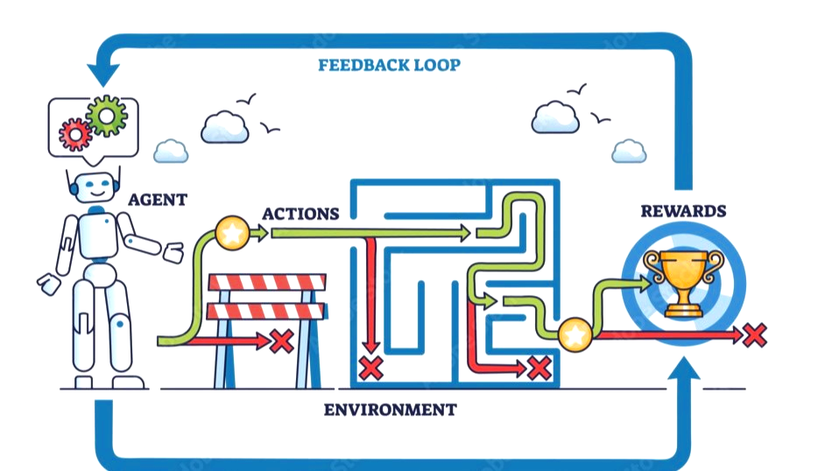


What is Reinforcement Learning?
Reinforcement Learning is a type of machine learning where an agent learns to make decisions by interacting with an environment and receiving feedback
Like Learning to Ride a Bike
You try different actions (pedaling, steering)
You get immediate feedback (balance or fall)
You learn from mistakes and successes
You improve through practice
Eventually, it becomes automatic
The key: Learning happens through trial, error, and feedback—not explicit programming

Slide 8


Why RL for Racing?
Reinforcement Learning is Perfect for Racing
Three key advantages make RL ideal for this challenge
No Manual Rules Required
We don't need to manually program racing strategies. The AI discovers optimal racing lines, braking points, and acceleration patterns on its own.
Discovers Optimal Strategies
Through millions of attempts, the AI finds racing strategies that might not be obvious to human programmers—sometimes even surpassing human intuition.
Adapts to Changes
If the track physics or rules are adjusted, we can retrain the AI to adapt. Traditional rule-based systems would need complete reprogramming.
No need to code: 'IF curve_radius < 50 THEN reduce_speed_by_30'
May discover: Taking a wider line in one corner to set up perfectly for the next
Same algorithm works on: Different track layouts, various weather conditions, modified physics

Slide 9

The RL Learning Cycle
The racing AI continuously repeats this four-step cycle:
Observe
Observes state: position, speed, and track data.
Act
Chooses an action: accelerate, brake, or turn.
Reward
Receives rewards for progress and penalties for
mistakes.
Learn
Updates its policy to improve future decisions.
This cycle repeats millions of times during training.

Slide 10
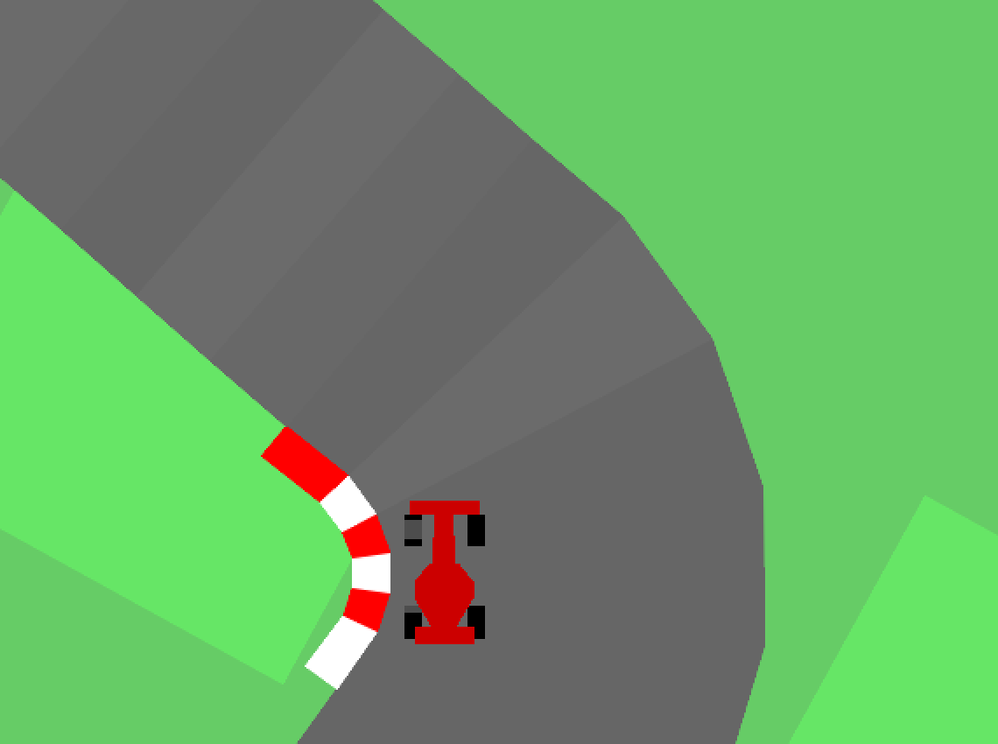
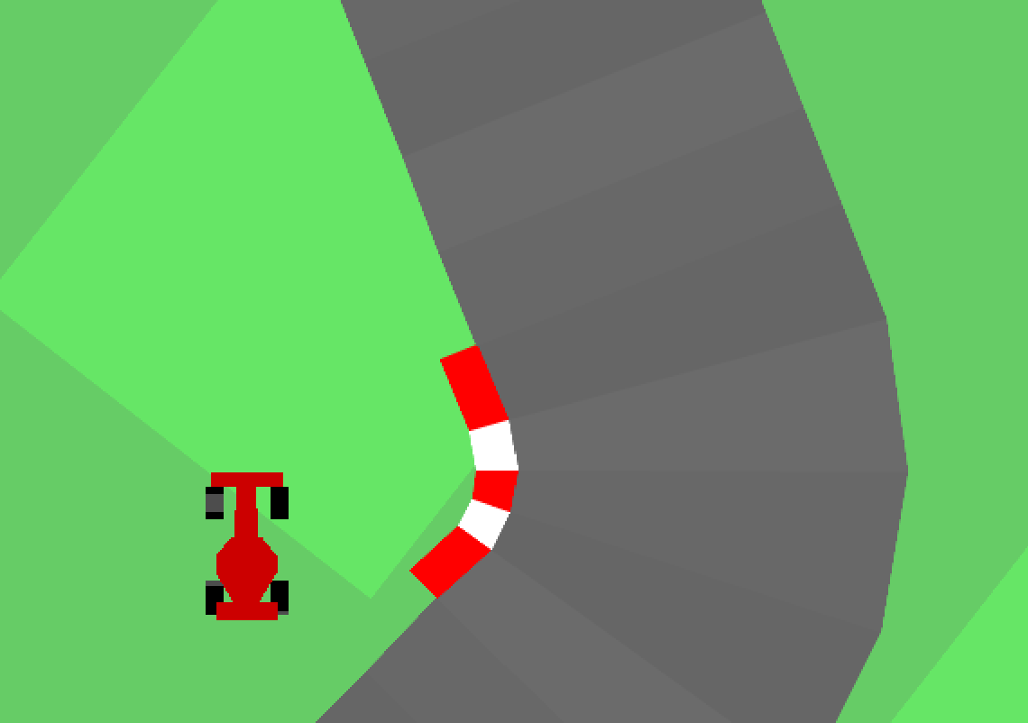
Rewards and Penalties
The reward function is the teacher that guides learning. It defines what's good and what's bad behavior.
Positive Rewards
+ Moving forward on the track → +1 per step
+ Staying near center of track → +0.5 bonus
+ Maintaining optimal speed → +0.3 bonus
+ Completing a lap → +100 bonus
+ Smooth steering (avoiding jerky movements) → +0.2
Penalties (Negative Rewards)
Going off track → -10 per step
Hitting track boundary → -50 and episode ends
Driving too slow → -0.5 per step
Excessive steering → -0.3 per step
Driving backward → -5 per step

Slide 11
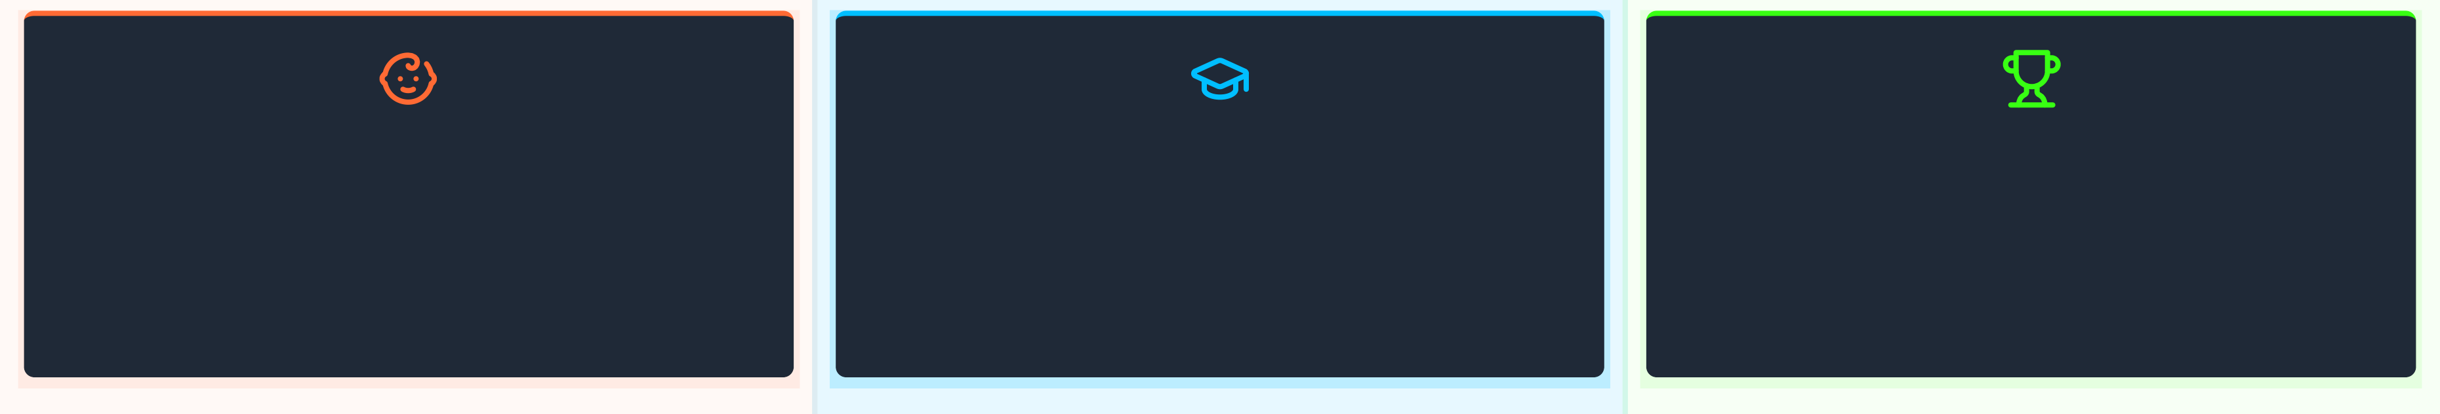
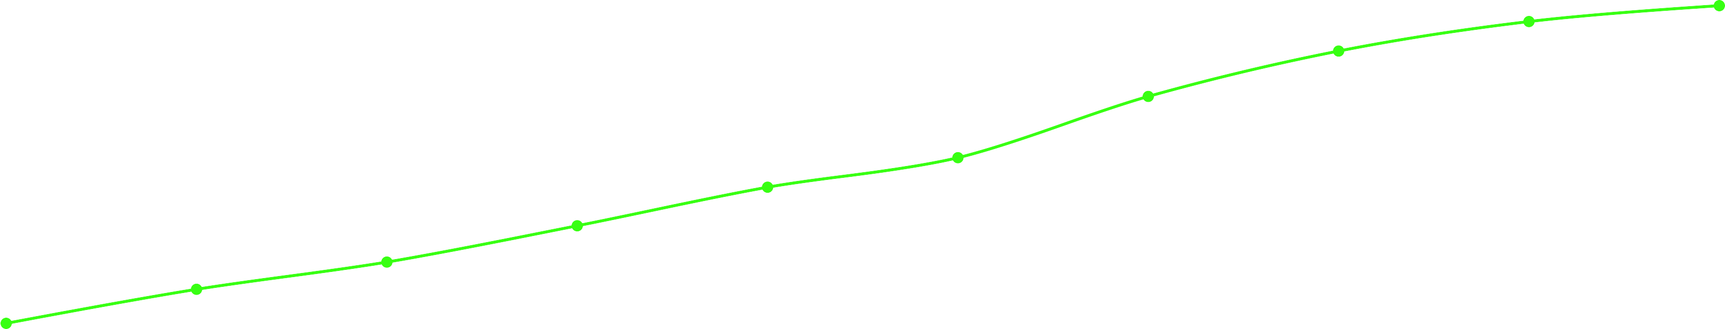
Learning Over Time
Early Training
Chaotic, off-track movements
Average reward: -50 to -20
Mid Training
Learning track boundaries
Average reward: -5 to +20
Late Training
Smooth, expert driving
Average reward: +80 to +100
Improvement Over Training Episodes
Average Reward per Episo
135
90
45
0
-45
0
100
200
500
800
1000
Training Episodes
1500
2000
2500
3000
Slide 11/25

Slide 12


Essential Vocabulary Part 1
Understanding the Core Components
Agent
The learner or decision-maker that takes actions
→ In our case: The AI-controlled racing car
Like the driver in a real race
Environment
The world the agent interacts with
→ In our case: The racing track, physics simulation, and track boundaries
Like the race course and its rules
State
The current situation or observations the agent perceives
→ In our case: Car position, velocity, distance to track edges, steering angle
Like what the driver sees and feels
Action
A decision or move the agent can make
→ In our case: Steering angle (-1 to +1), Acceleration (0 to 1)
Like turning the wheel or pressing the gas pedal
Slide 12/25

Slide 13

Essential Vocabulary Part 2
Understanding Feedback and Learning
Reward
Numerical feedback signal indicating how good an action was
→ In our case: Positive for staying on track and moving forward, negative for crashes
Like a score that tells the driver if they're doing well
Policy
The agent's strategy for choosing actions based on states
→ In our case: The neural network that maps observations to steering and acceleration decisions
Like the driver's racing strategy and instincts
Episode
One complete run from start to finish (or crash)
→ In our case: From starting position until lap completion or going off- track
Like one practice lap in racing
Training
The process of running many episodes to improve the policy
→ In our case: Running thousands of episodes while the neural network learns better racing strategies
Like practicing on the track to improve lap times
Slide 13/25

Slide 14


PPO Algorithm Introduction
Proximal Policy Optimization (PPO)
PPO is a modern reinforcement learning algorithm that balances exploration and stability during training It's one of the most popular and effective algorithms for training agents in complex environments
Stable Learning
PPO prevents the policy from changing too drastically between updates, avoiding catastrophic forgetting and ensuring steady improvement
Sample Efficient
It reuses collected experience multiple times through multiple training epochs, making better use of data and speeding up learning
Easy to Tune
Compared to other RL algorithms, PPO has fewer hyperparameters and works well with default settings, making it beginner-friendly
Why We Chose PPO for Racing
Proven success in complex control tasks (robotics, games)
Good balance between exploration and exploitation
Stable and reliable training process
Industry standard for continuous control problems
Slide 14/25

Slide 15
DQN Algorithm Introduction
Deep Q-Network (DQN)
DQN is a foundational deep reinforcement learning algorithm that combines Q-learning with deep neural networks.
It’s one of the earliest and most influential algorithms for training agents directly from high-dimensional input such as images.
Stable Learning
DQN uses target networks and experience replay to stabilize learning, minimizing correlations between consecutive updates and preventing divergence.
Sample Efficient
By storing and reusing past experiences from the replay buffer, DQN improves data efficiency and learns effectively from fewer environment interactions.
Easy to Implement
DQN has a straightforward architecture and training procedure, making it one of the most accessible entry points into deep reinforcement learning.
Why We Chose PPO for Racing
Proven success in visual and discrete control tasks
Good balance between performance and simplicity
Stable training through target networks and replay buffers
Widely used baseline in deep reinforcement learning research
Slide 15/25

Slide 16
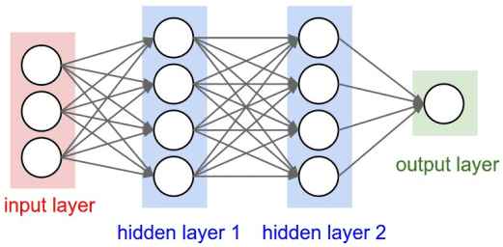
The Neural Network
network.py
How It Works
Input Layer
Receives environment state (e.g., speed, position).
Hidden Layers
Processes state to find optimal driving patterns.
Output Layer
Outputs steering & acceleration commands.
Slide 16/25

Slide 17




The Training Loop
train.py
The training script orchestrates the learning process:
Initialize
Create environment, network, and PPO optimizer.
Run Episodes
Reset environment and collect experience from the track.
Collect Data
Store observations, actions, and rewards in a buffer.
Update Policy
Use PPO to update network weights with collected data.
Save Checkpoints
Periodically save the trained model to disk.
Repeat
Continue for thousands of episodes until performance plateaus.
[CODE PLACEHOLDER]
train.py
Main training loop structure
def train():
# Initialize environment, network, optimizer env, network, ppo = setup()
for
episode in range(NUM_EPISODES):
# Collect experience by running an episode episode_data = run_episode(env, network)
# Update policy with collected data ppo.update(episode_data)
# Save checkpoint periodically if
episode % SAVE_INTERVAL == 0: network.save(f'model_{episode}.pth')
Slide 17/25

Slide 18




PPO Algorithm in Action
PPO ensures stable learning with careful policy updates.
Collect Experience
Gather data from multiple simulation runs.
Calculate Advantages
Evaluate actions to see which were better than average.
Update Policy (Clipped)
Update the policy, clipping changes to ensure stability.
Repeat
Reuse the same data for several updates (epochs).
Key idea: Keep updates 'proximal' (close) to the current policy.
Slide 18/25

Slide 19


Racing Trained Agents
race.py
[CODE PLACEHOLDER]
race.py
Loading and racing trained models
Watch trained AI agents race in real-time.
import pygame from
network import RacingNetwork
Load Trained Models
Load saved model weights from training checkpoints.
def race():
# Initialize PyGame & Environment pygame.init()
env = RacingEnvironment()
Multiple Agents
Race multiple agents simultaneously on the same track.
PyGame Visualization
Render the race in real-time using PyGame.
# Load trained models
agent1 = RacingNetwork.load('team1.pth') agent2 = RacingNetwork.load('team2.pth')
# Race loop while racing:
# Get actions from models action1 = agent1.predict(obs1)
...
Performance Metrics
Track lap times, speed, and agent positions.
The perfect tool for running competitions!
# Update & Render environment env.step([action1, action2]) env.render()
Slide 20/25

Slide 20
Hyperparameters You Can Tweak
These are the key 'knobs' to adjust your AI's learning behavior.
Hyperparameter | What It Does | Typical Range | Our Default
Learning Rate | Controls how fast the model learns | 0.0001 - 0.01 | 0.0003
Discount Factor (γ) | Balances immediate vs. future rewards | 0.9 - 0.999 | 0.99
Training Episodes | Total number of training simulations | 1k - 10k | 3,000
Batch Size | Data points per training update | 32 - 512 | 128
Clip Range | Limits the change in policy per update | 0.1 - 0.3 | 0.2
Network Architecture | Size of the neural network | Varies | [64, | 64]
Entropy Coefficient | Encourages the agent to explore | 0.0 - 0.1 | 0.01
GAE Lambda | Factor for advantage estimation | 0.9 - 0.99 | 0.95
Continuous? | Says whether decisions are continuous or discrete | True/False | False
Customization →
Slide 21/25

Slide 21
Reward Function Customization
The reward function is the most powerful tool for shaping your AI's behavior
⚡ Speed Rewards
Adjust weight of forward progress
Higher weight → More aggressive, speed-focused driving
🎯 Center Bonus
Reward staying near track center
Higher weight → Smoother, safer racing lines
❌ Crash Penalty
Penalty for hitting boundaries
Higher penalty → More cautious, conservative driving
📊 Smoothness Reward
Reward steady steering and acceleration
Higher weight → Less jerky, more stable control
The Art: Balancing speed vs. safety through reward weights
[BEFORE/AFTER EXAMPLES PLACEHOLDER]
Speed-Optimized Rewards
Before: Forward progress weight: 1.0, Center bonus: 0.5 After: Forward progress weight: 2.0, Center bonus: 0.2 Result: Car takes riskier lines but achieves faster lap times
Safety-Optimized Rewards
Before: Crash penalty: -50, Center bonus: 0.5 After: Crash penalty: -100, Center bonus: 1.0
Result: Car drives more conservatively but completes laps reliably
Will include: Side-by-side racing path comparisons showing trajectory differences

Slide 22


Summary
What We've Learned
Key Takeaways from Training AI Racing Cars with Reinforcement Learning
₁ The Challenge
₂ Reinforcement Learning
Teaching cars to race autonomously is complex—requiring balance between speed, control, and adapting to physics without explicit programming
RL enables AI to learn through trial and error, receiving rewards for good behavior and penalties for mistakes—like teaching through experience
₃ The Learning Cycle
₄ PPO Algorithm
The AI continuously observes, acts, receives rewards, and learns— improving its policy through thousands of episodes of practice
PPO provides stable, efficient training by carefully updating the policy in controlled steps—avoiding wild swings in behavior
₅ Implementation
₆ Customization
Four main components work together: environment (track & physics), neural network (brain), training loop (learning process), and racing script (visualization)
You can customize hyperparameters, reward functions, track layouts, and physics to create unique racing challenges and behaviors

Slide 23

Questions & Next Steps
Questions?
Open for discussion on RL, AI racing, and implementation.
Ready to Get Started?
Clone the DcmHighwayEnv repo from GitHub
Install dependencies (Python, PyTorch, PyGame)
Run the default training script
Experiment with rewards & hyperparameters
Thank you!
Slide 25/25

